Slide 1

Notes:
clarityAI helps ML developers interpret their models’ predictions

Slide 2
Table of Contents
01
Introduction to Interpretability
02
Case Study 1: COMPAS
03
Case Study 2: Brain Tumor Identification
04
clarityAI.
Notes:
First, we’ll introduce you to the concept of interpretability, then we’ll talk about our two experiments/case studies that we did on interpretable models, and finally, we’ll present clarityAI!

Slide 3
01
What is Interpretability?
Notes:
First up, let’s talk about what interpretability in ML is

Slide 4



PREDICTION
DATA
Notes:
Here is a rough representation of most ML models, where you feed in data and get out a prediction
But how the model makes the prediction is often a black box

Slide 5


PREDICTION
DATA
“Taking into account X in the data I deduced Y to produce Z”
Notes:
Ideally, we would want to be able to see inside the black box and be able to tell stakeholders “taking into account X in the data, I deduced Y to produce Z”.

Slide 6

?
PREDICTION
DATA
“Yeah… wish I could help”
Notes:
However, that usually isn’t the case and how models arrive at predictions is unknown.

Slide 7
Interpretability
Notes:
And so interpretability aims to solve this problem by helping humans understand the predictions of ML.
This in turn helps with transparency + trust
Especially crucial for models used for high-stakes decision making

Slide 8
Interpretable Models
Interpretability Methods
Notes:
There are two main ways to approach interpretability
Replace complex models with inherently interpretable ones without sacrificing performance
Use ad-hoc methods to explain models’ predictions
For our two case studies, we focus on applying interpretable models and measuring their performance against their complex model counterparts.

Slide 9
02
COMPAS
Notes:
The first case study we did was on COMPAS.
This algorithm was originally released by Northpointe to assess a criminal defendant’s likelihood of becoming a recidivist - criminals who reoffend.
An analysis of COMPAS found that black defendants were more likely to be incorrectly judged to be at a higher risk of recidivism, while white defendants were more likely than black defendants to be incorrectly flagged as low risk.
Even when controlling for prior crimes, future recidivism, age and gender, black defendants were 45 percent more likely to be assigned higher risk scores than white defendants. White violent recidivists were 63 percent more likely to have been misclassified as low risk of violent recidivism, compared to black violent recidivists.
Clearly, COMPAS has a bias issue, and we wondered if it was necessary for it to use such a complex model - taking in over 130 features.

Slide 10
Task: Predict 2-year recidivism (Yes/No)
Complex: DNN
Interpretable: Logistic Regression
Notes:
And so In our experiment, we tried to predict 2-year recidivism with both a DNN, which is a complex black-box model, and logistic regression, which is an inherently interpretable model.
Using the same dataset, the DNN model took in 13 features while our logistic regression only looked at 2 features (age and number of priors).

Slide 11
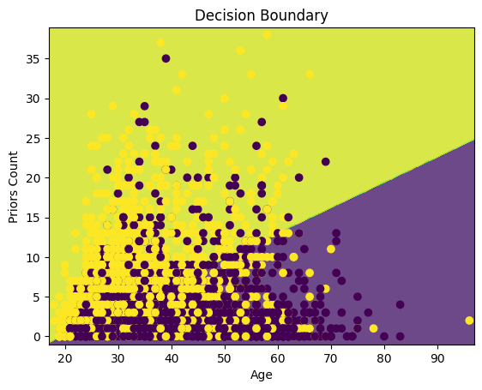
Interpreting Logistic Regression
Notes:
As you can see, logistic regression is interpretable because there’s a decision boundary that you can reference to see how it makes its predictions.
For example, if you’re 30 and have over 3 priors, then the logistic regression will predict you’ll get arrested again in 2 years.

Slide 12
COMPAS’ accuracy:
62.5%
Accuracy Comparison
 | DNN | Logistic Regression
Accuracy | 0.7368 | 0.6791
Precision | 0.7640 | 0.6996
Recall | 0.6186 | 0.5205
F1 score | 0.6165 | 0.5969
AUC-ROC | 0.8069 | 0.7285
Notes:
But how do the models compare in terms of accuracy?
On top of being interpretable, logistic regression has similar accuracy to the DNN based on multiple different accuracy metrics.
[CLICK] And for reference, the actual COMPAS model (produced by Northpointe) has an accuracy of around 62%

Slide 13
Fairness Comparison
 | PPR for Caucasians | PPR for African-Americans | Difference between PPRs
DNN | 0.4808 | 0.6479 | 16.71%
Logistic Regression | 0.2354 | 0.4411 | 20.57%
Notes:
We also compared fairness through statistical parity. PPR, in the table, is positive prediction rate. Statistical parity looks at how similar PPR is between groups.
The two models again performed similarly, with the PPR for African-Americans always being higher than for Caucasians regardless of the models used - probably because the bias mostly comes from the dataset itself and not the use of a specific model.

Slide 14
03
Brain Tumor Classification
Notes:
For our next case study we chose to look at brain tumor classification

Slide 15
Task: Image classification (15 classes)
Complex: CNN
Interpretable: SVM
Notes:
This is a multiclass image classification task - quite different from COMPAS. There were 15 classes of tumors and we used a CNN and a SVM to classify them.
SVMs are interpretable because you can visualize the decision boundary and identify the support vectors. However, CNNs are usually preferred for the task of image classification.

Slide 16
Accuracy Comparison
 | CNN | SVM
Accuracy | 0.9104 | 0.8657
Average F1 score | 0.8586 | 0.88
Notes:
Here, we compared accuracy again, and saw that the performance was similar between the models. However, our dataset was relatively small and we don’t know if performance of an SVM will scale for larger datasets.

Slide 17
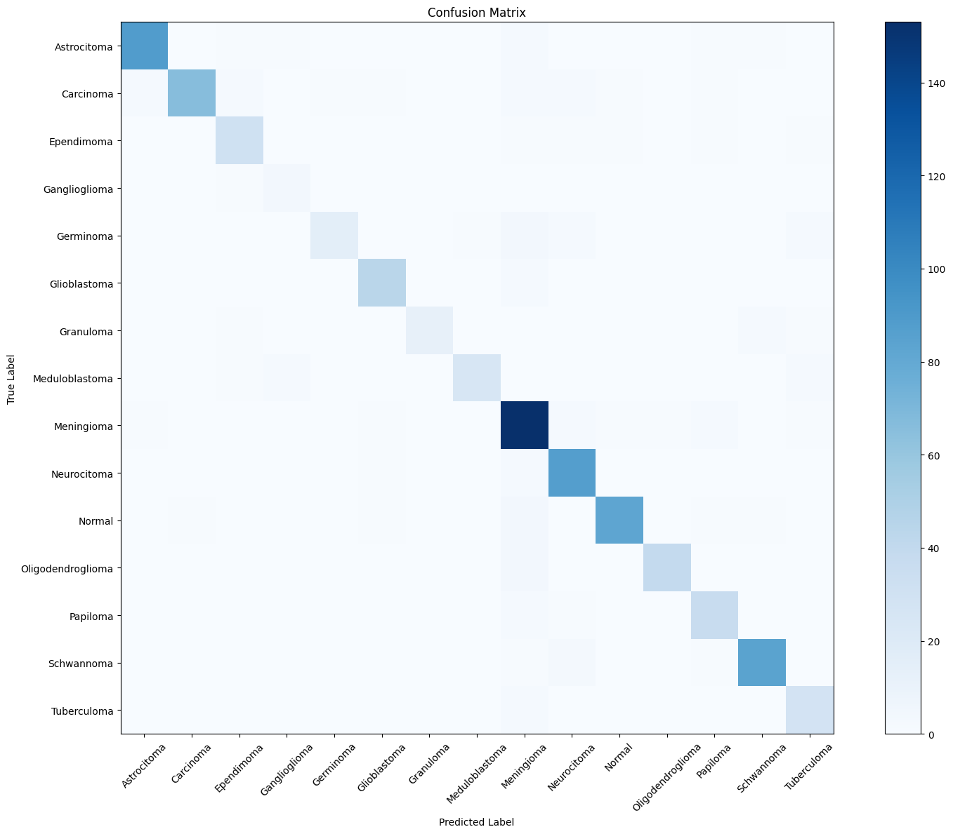
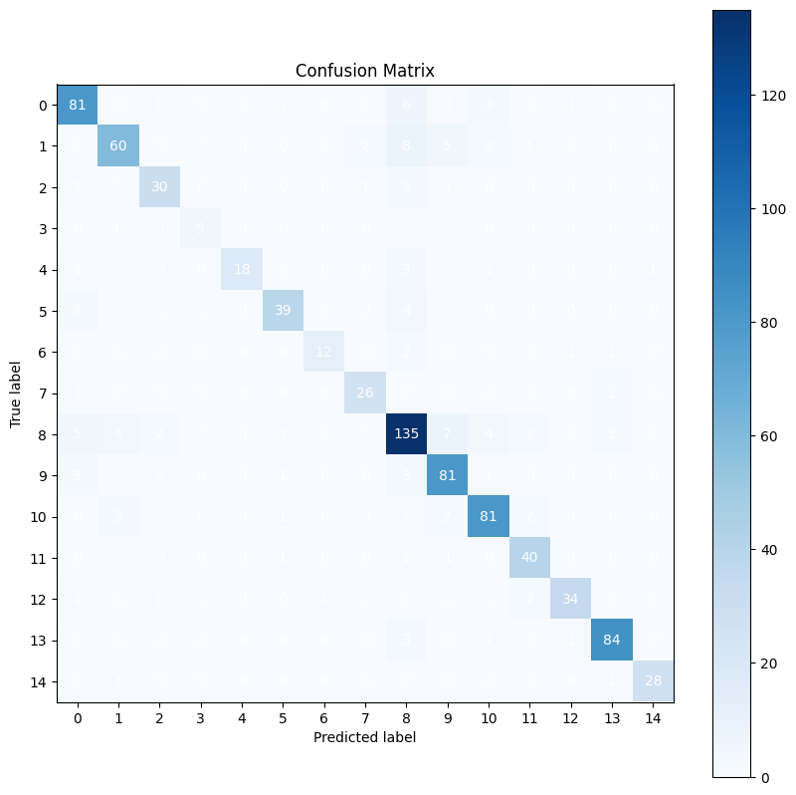
Confusion Matrix Comparison
CNN
SVM
Notes:
By observing the confusion matrices, our models also performed similarly for each class.

Slide 18
What if we don’t want to replace DNNs/CNNs?
Notes:
In the last two experiments - COMPAS and brain tumor classification - we showed that in certain scenarios, interpretable models can very much be comparable to complex models in performance.
However, people are often reluctant to abandon complex models entirely and there are currently research limits on how much interpretable models can replace tasks performed by black-box models.
And so we pivot to interpretability methods!

Slide 19
04
clarityAI.
Notes:
And this is where our product, clarityAI, fits in!

Slide 20
clarityAI helps ML developers interpret their models’ predictions
Notes:
clarityAI helps ML developers interpret their models’ predictions
As you just saw - implementing interpretability in ML took a lot of research and effort, something that a lot of student/hobby ML developers won’t have the time or energy to do themselves.

Slide 21
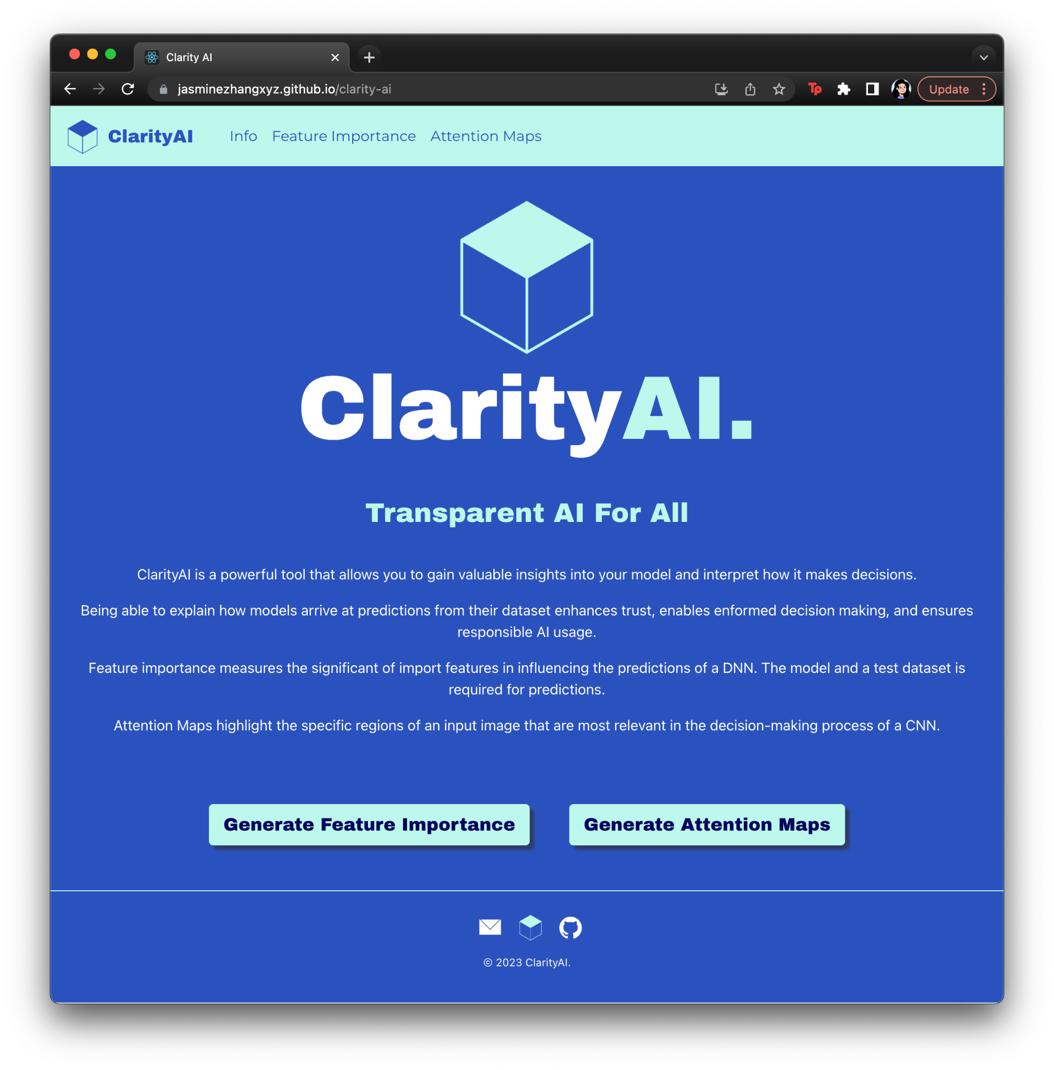
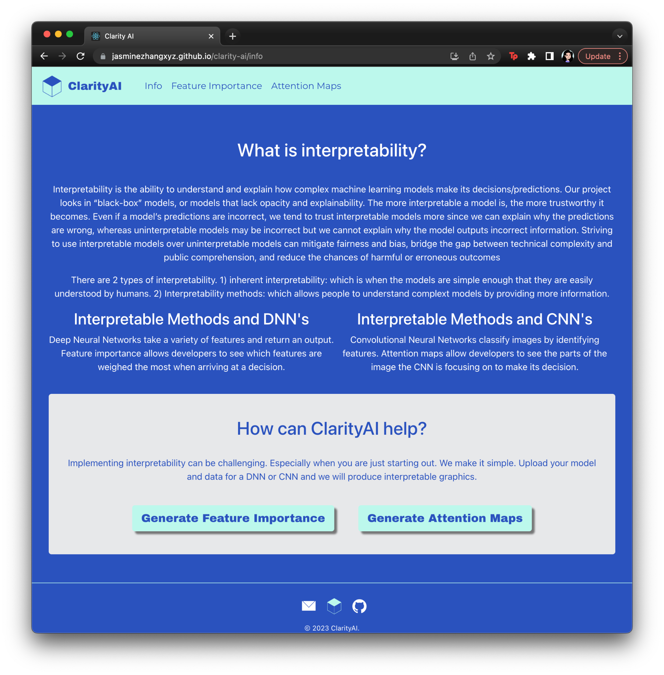
Home Page
Info Page
Notes:
And so our website aims to help them with this issue. We currently have 2 methods implemented for 2 types of models, DNN and CNN. We also have an info page which goes into more detail about our project.

Slide 22
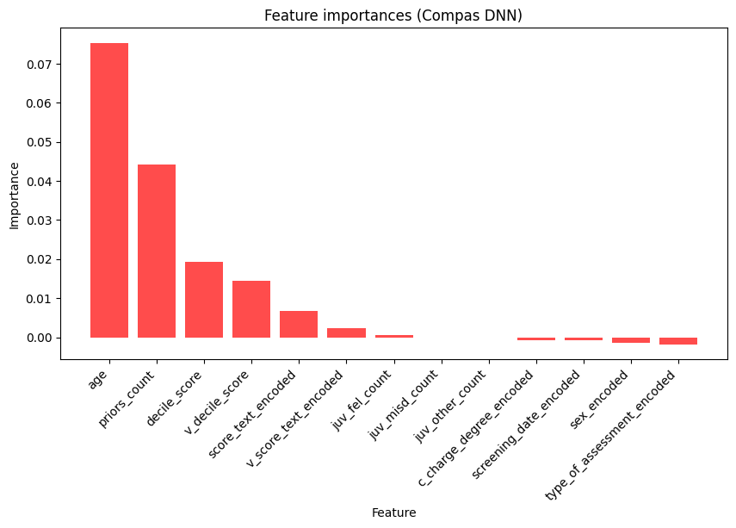
Feature Importance
Notes:
First up, we have feature importance! This interpretability method calculates which features the models considers the most when making predictions.
The graph here shows the different feature importances of our DNN model for COMPAS. As you can see, “age” and “priors_count” is weighed the most heavily.
However, feature importance assumes that the user has a strong understanding of domain knowledge, as it does not tell you what it is about those features it is looking at.

Slide 23
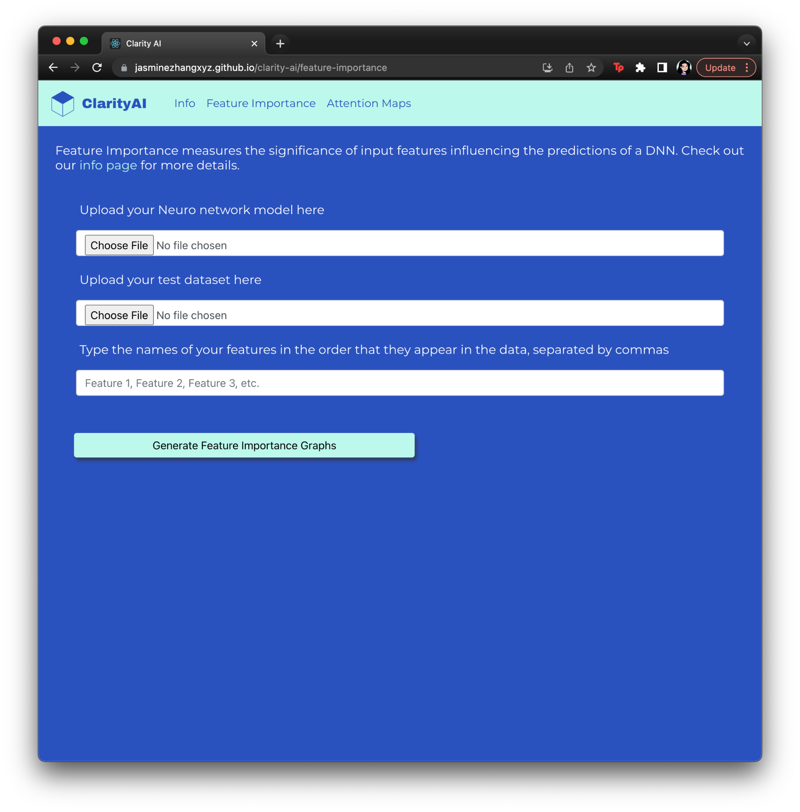
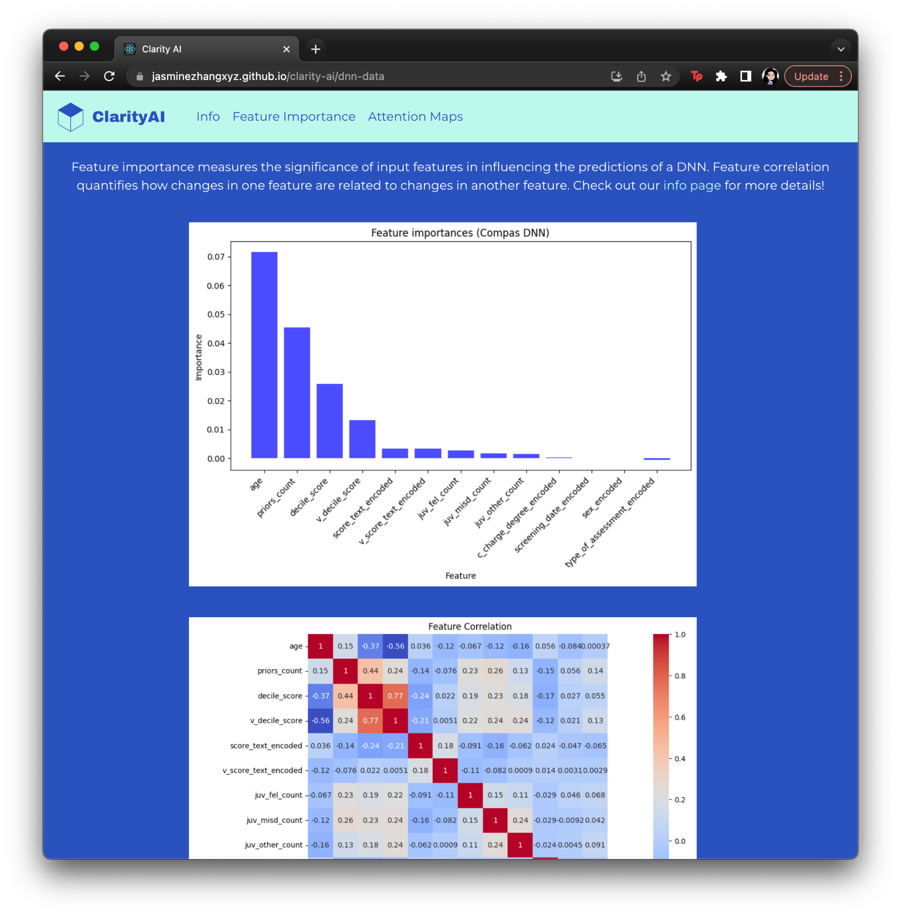
Data Upload Page
Feature Importance Results Page
Notes:
The idea for our website is to upload your DNN model, test dataset and the names of your features, then clarityAI calculates feature importance and feature correlation for you
Feature correlation measures the degree to which changes in one feature are related to changes in another feature.

Slide 24
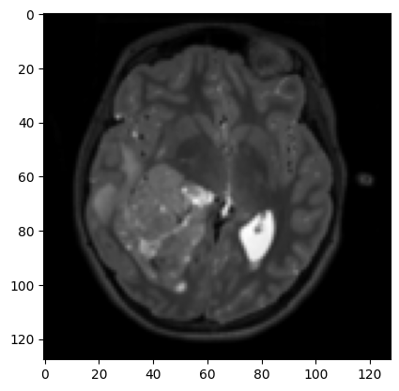
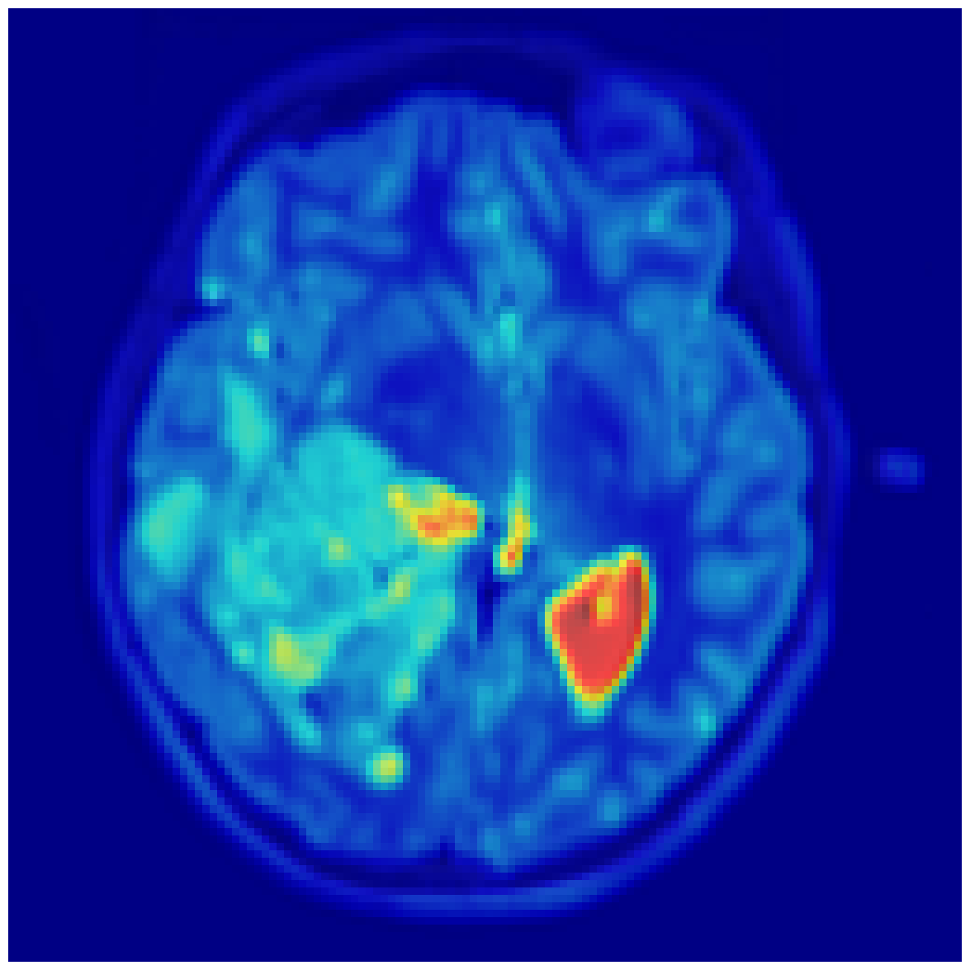
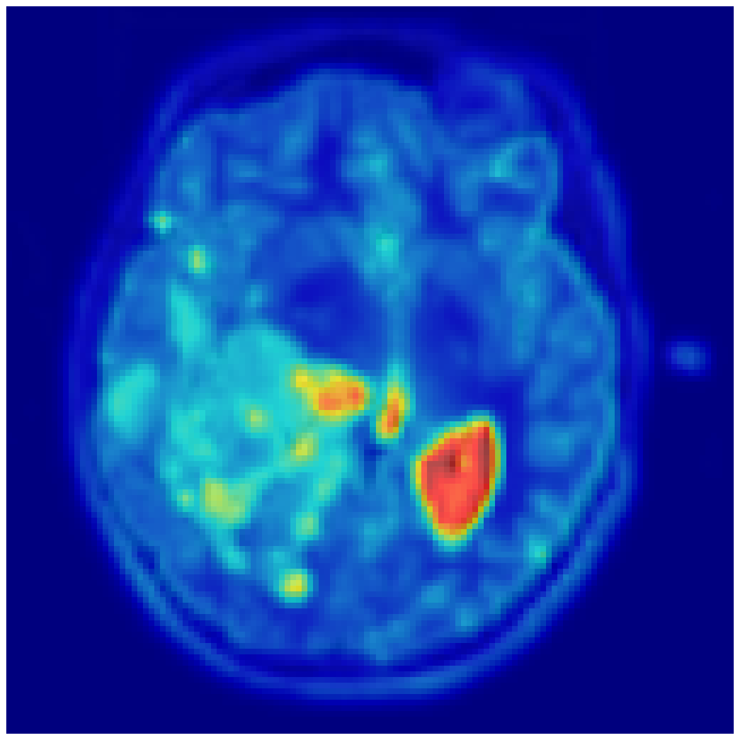
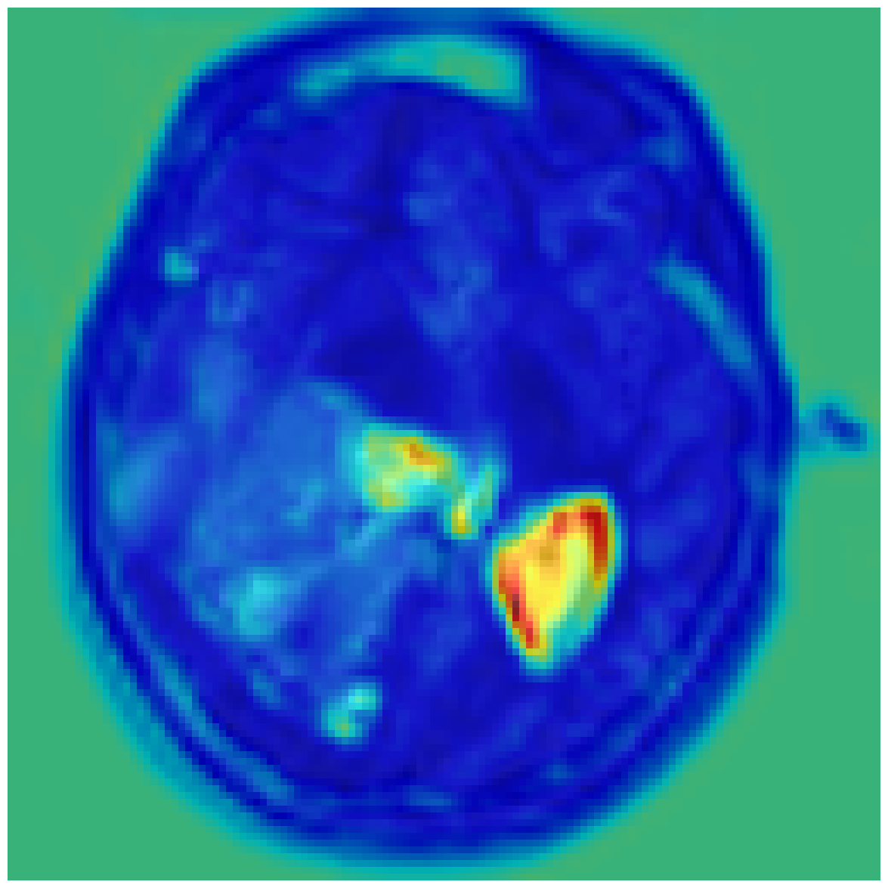
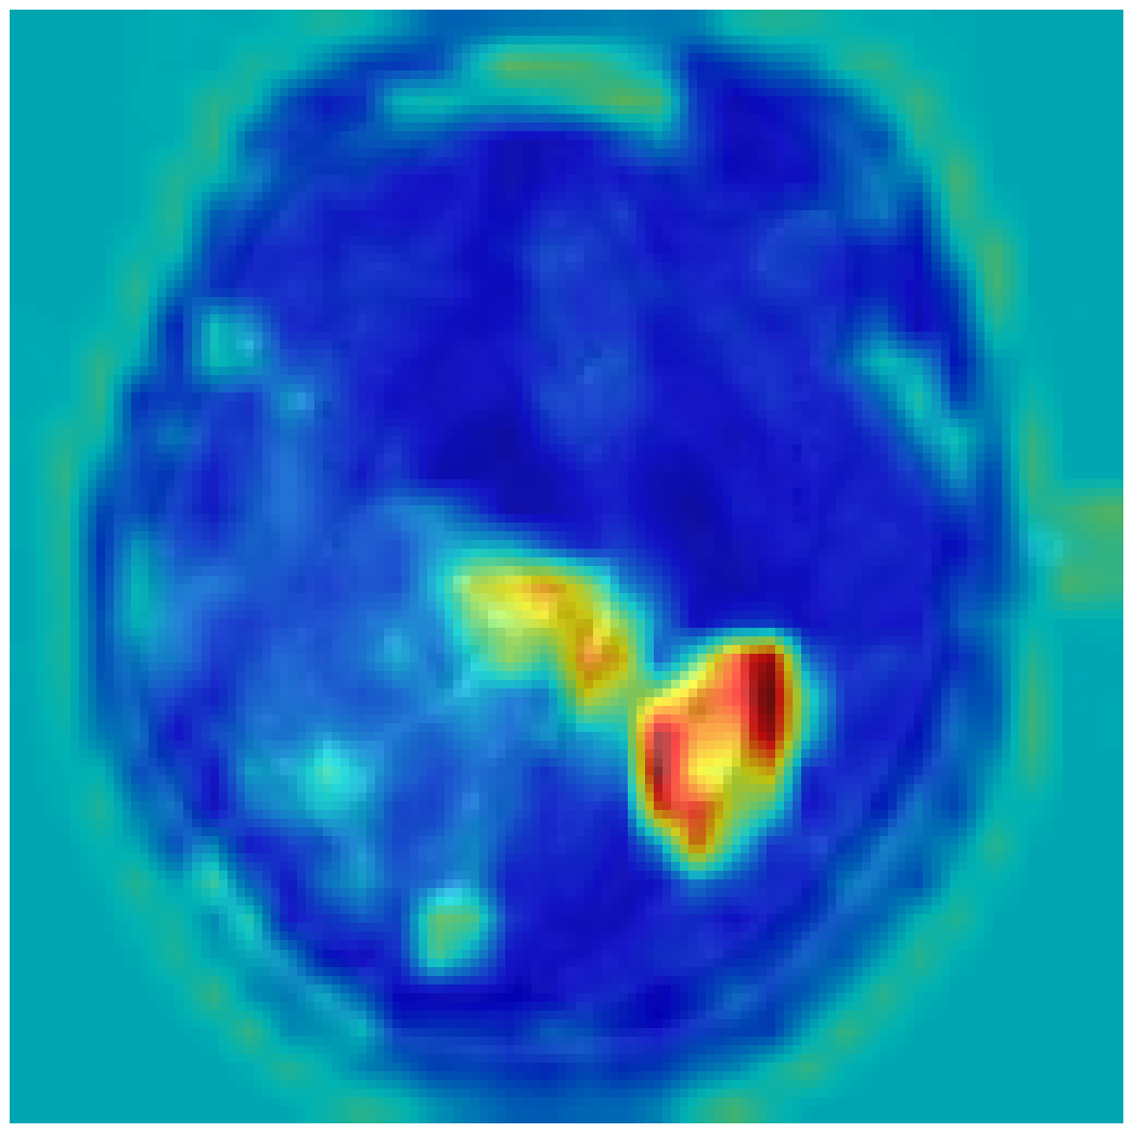
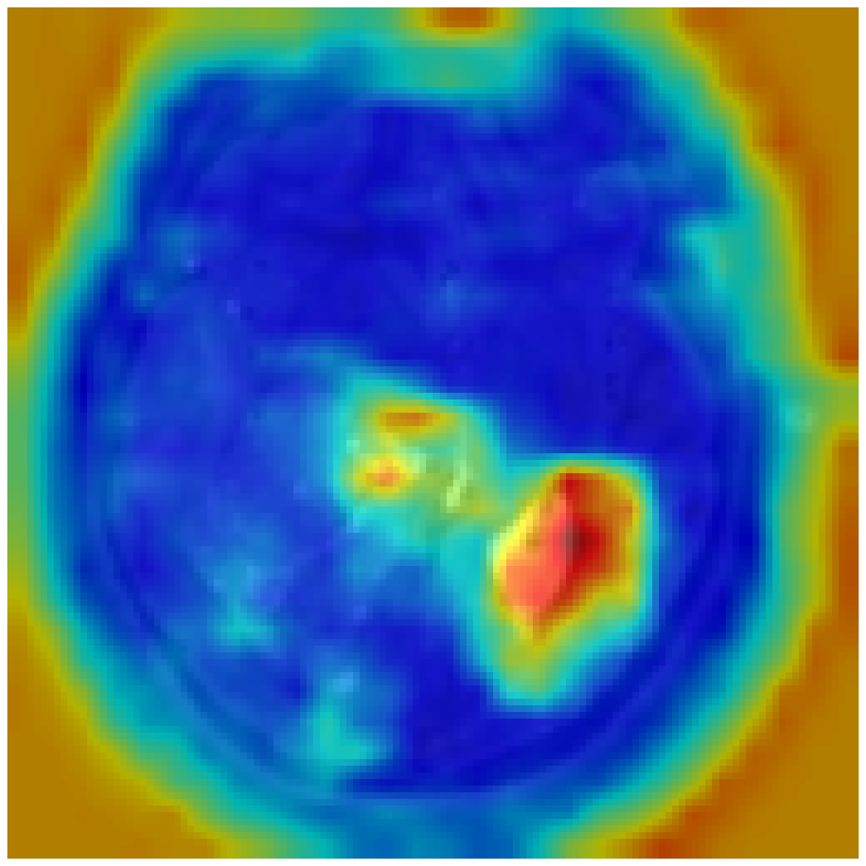
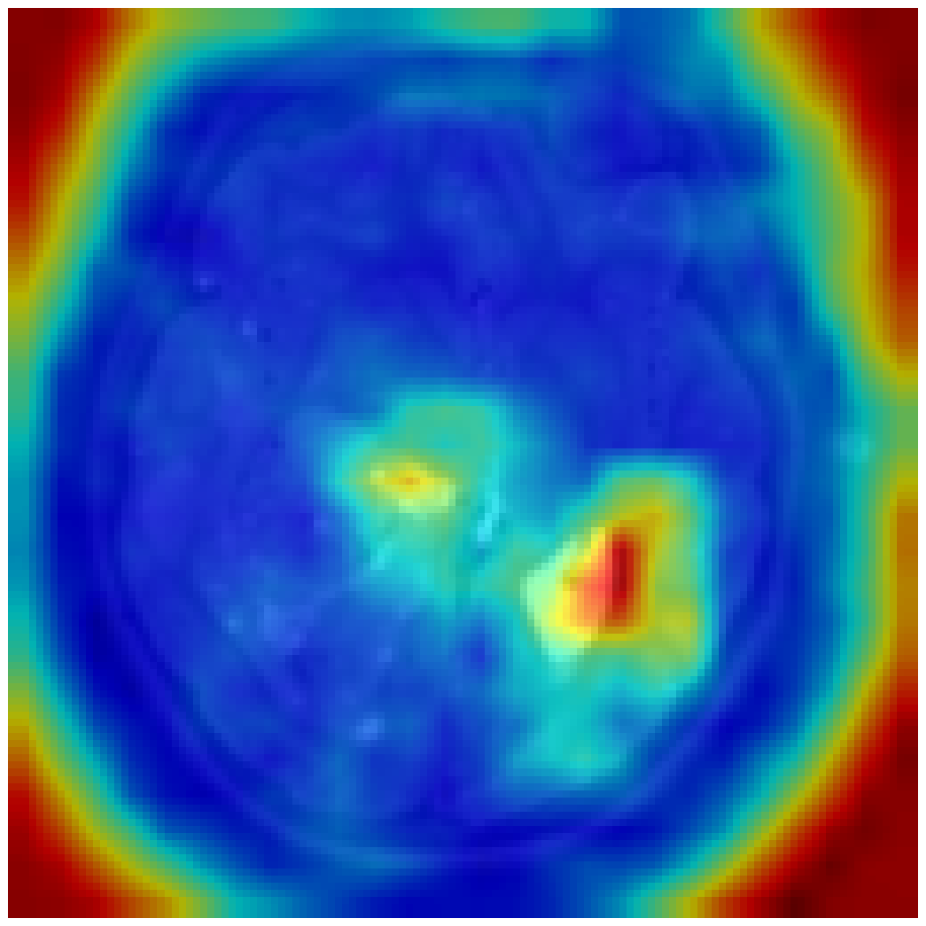
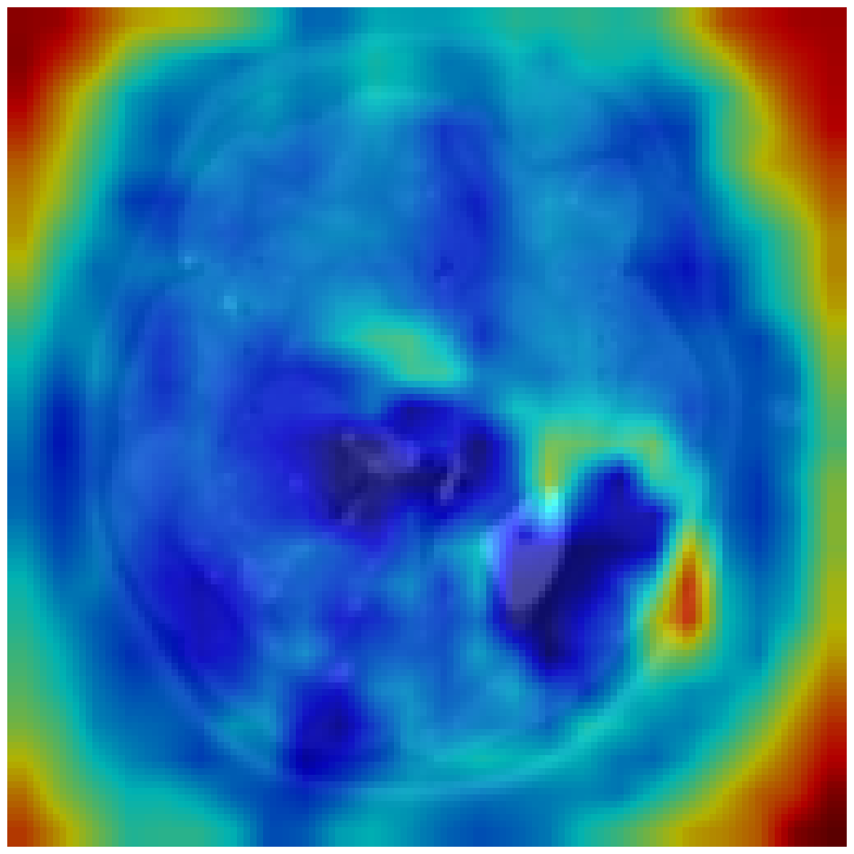
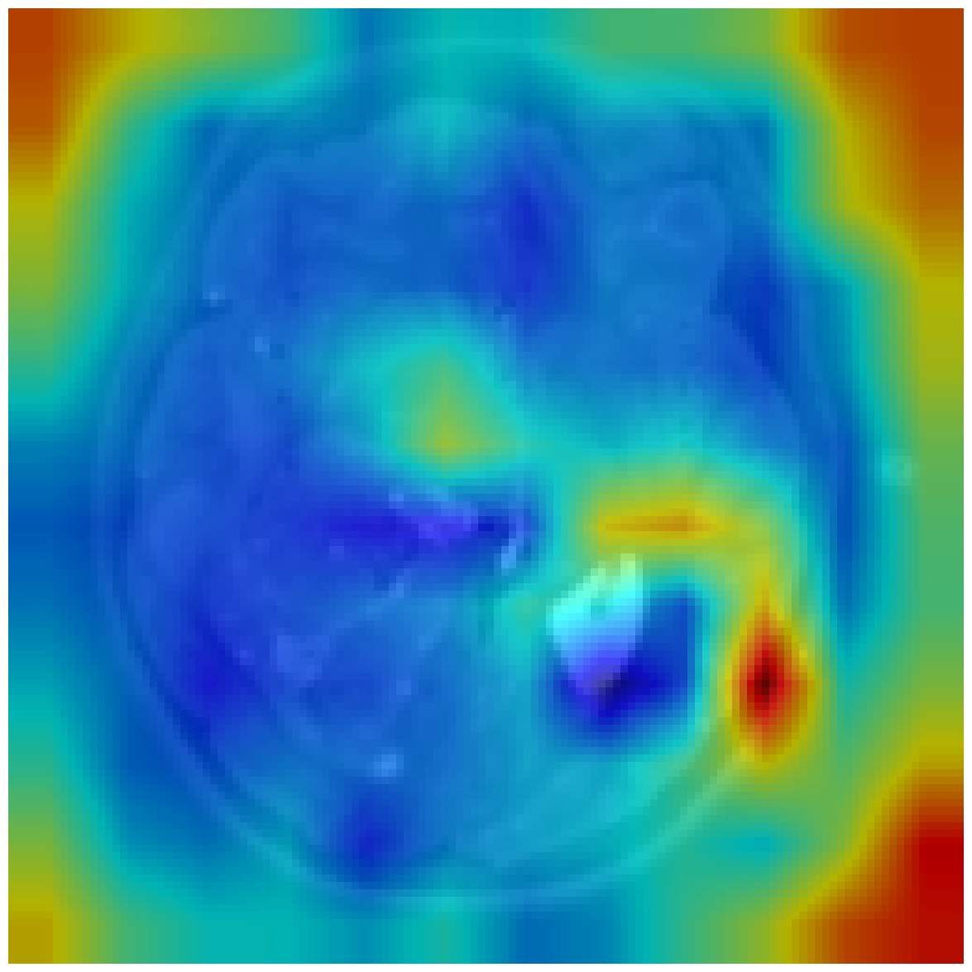
Attention Maps
Original Image
conv2d_1
max_pooling2d_1
conv2d_2
max_pooling2d_2
conv2d_3
conv2d_4
conv2d_5
max_pooling2d_3
Notes:
The second method we looked at was attention maps. Attention maps visualize the parts of the image the CNN focuses on at each layer.
In this example, we implemented attention maps on a CNN that classifies different types of brain tumors. Again, this is a sensitive task and so it’s important to visualize where the model is focusing on.

Slide 25
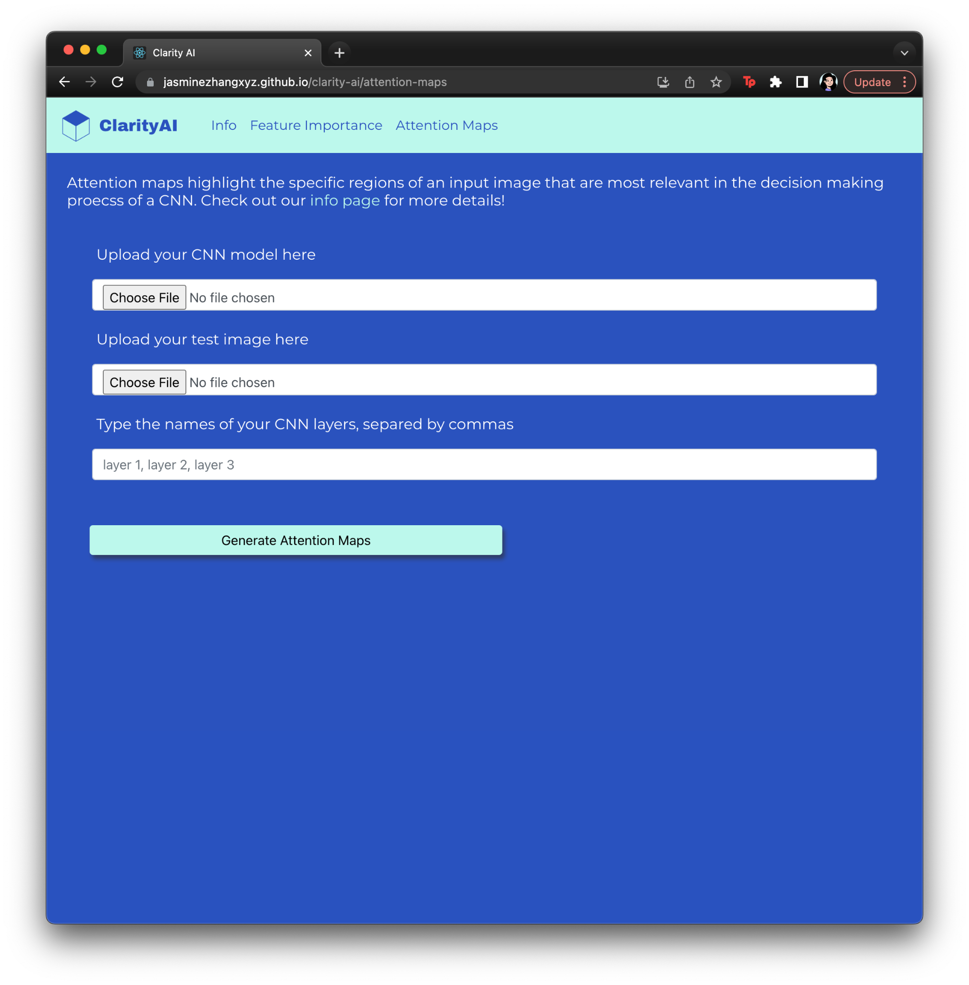
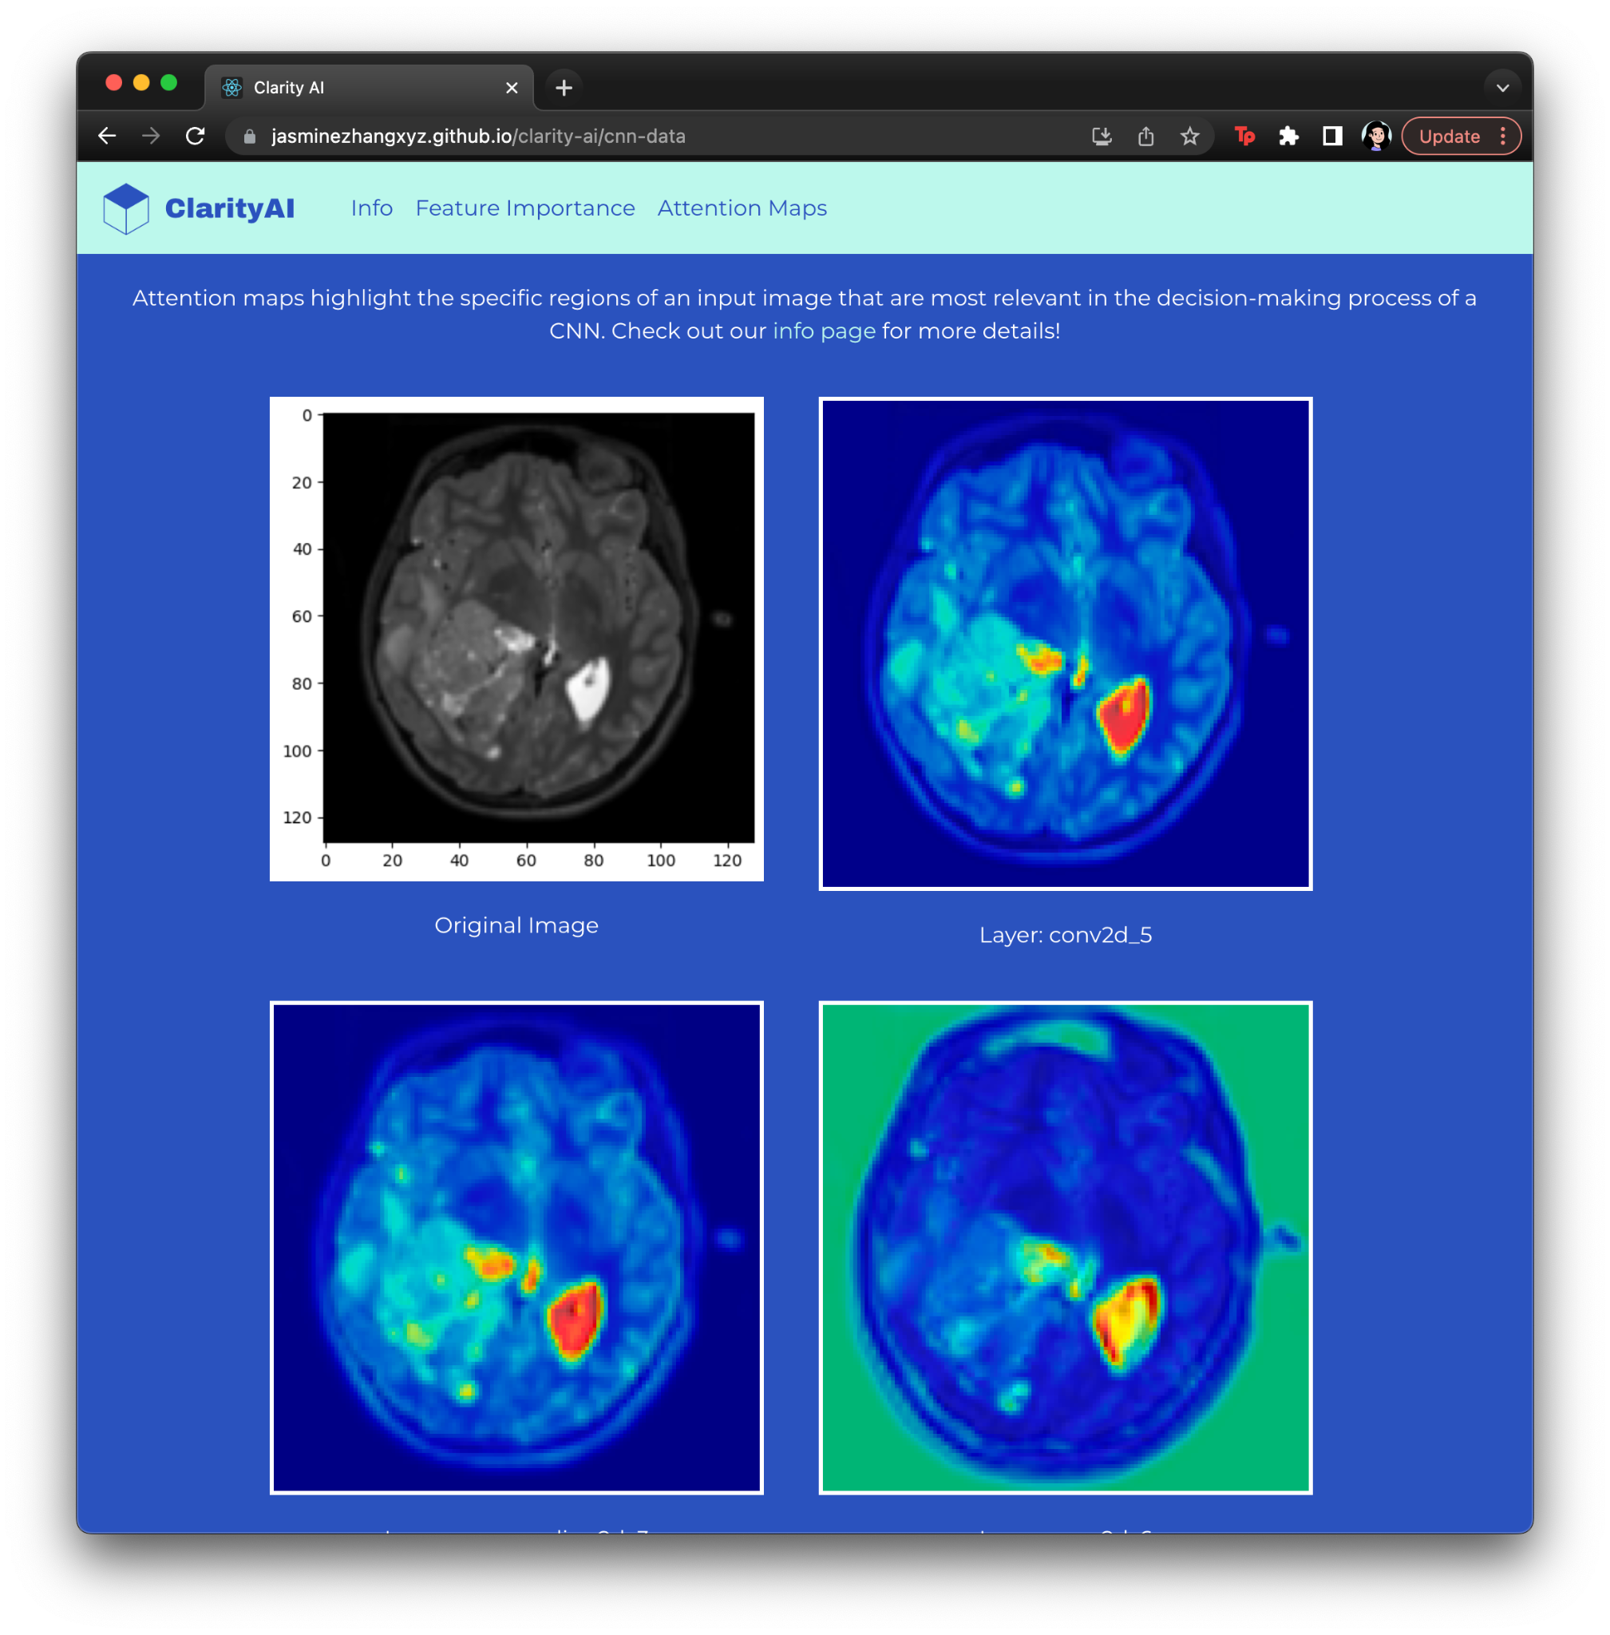
Data Upload Page
Attention Maps Results Page
Notes:
The same idea applies here, where users upload the necessary files and we generate attention maps for a CNN for them

Slide 26
Limitations
Privacy Concerns
Potential for Misuse
Limited Resources
Notes:
However, this idea comes with multiple limitations and ethical concerns.
Privacy concerns: asks for people to upload models, data, etc.
Potential for misuse:
Limitations to interpretability methods
Misunderstanding of when it is appropriate to use an interpretability method
Interpretability is a newer concept with new research still coming out!
Limited resources throughout project
Unknown scalability, could only test with relatively smaller models and datasets given our time/ computing power
(ask Viet + Ross)

Slide 27
Next Steps
Website → Python Package
Add more functionality
Notes:
Convert website into a python package (easier to use, takes away some concerns about asking people to upload private models/data, is quicker because we can remove upload time)
Add more interpretability methods so we can cover more complex models + tasks; add more guidelines of use for people (links to resources/papers)
Deep Neural networks
KNNs for interpretation
Kernel-based explanation
LIME (Local Interpretable Model-agnostic Explanations)
DeepLIFT (Deep Learning Important FeaTures)
Layer-wise Relevance Propagation (LRP)
Convolutional Neural networks
Concept Whitening (no package)
Distillation
Saliency maps
Grad-CAM (Gradient-weighted Class Activation Mapping)
Large language models
Attention Visualization
Rule-based Explanations

Slide 28
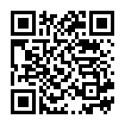
Thank You!
Questions?
https://jasminezhangxyz.github.io/clarity-ai/
Team members: Anna Lai, Jasmine Sun-Hu, Jasmine Zhang, Jeanine Ohene-Agyei, Matya Stavnitzky
TA: Viet Nguyen
Mentor: Ross Goroshin
Notes:
You can visit our website at the following link!

Slide 29
Back-Up Slide: Importance of Interpretability
Notes:
We want decision making to have reasoning that is understandable
Makes people feel better about ML
Enable trust, hence wider use of ML in the population (customers/ clients) that sees ML as black boxes
Embrace accessibility and encourage the general public to participate in ML (if they understand it, they can have their own opinions about the use and implementation of AI/ML)
Going forward, we can see AI being implemented in more fields, domains, and institutes that have a huge impact in people’s life. Hence trust is actually very important.
Example Japanese government drafted a white paper on usage of AI in government documents.
Can help with robustness/generalization

Slide 30
Back-Up Slide: Goal of clarityAI.
Notes:
Goal is to give people the tools to explore their models but NOT directly make conclusions about their models for them.
Use case: you’re a student/hobby ML developer that doesn’t know too much about interpretability - but you still want some help with interpreting your models. clarityAI can serve as a tool to help! There is no comprehensive package with state-of-the-art interpretability methods and so clarityAI helps fulfill this need.

Slide 31
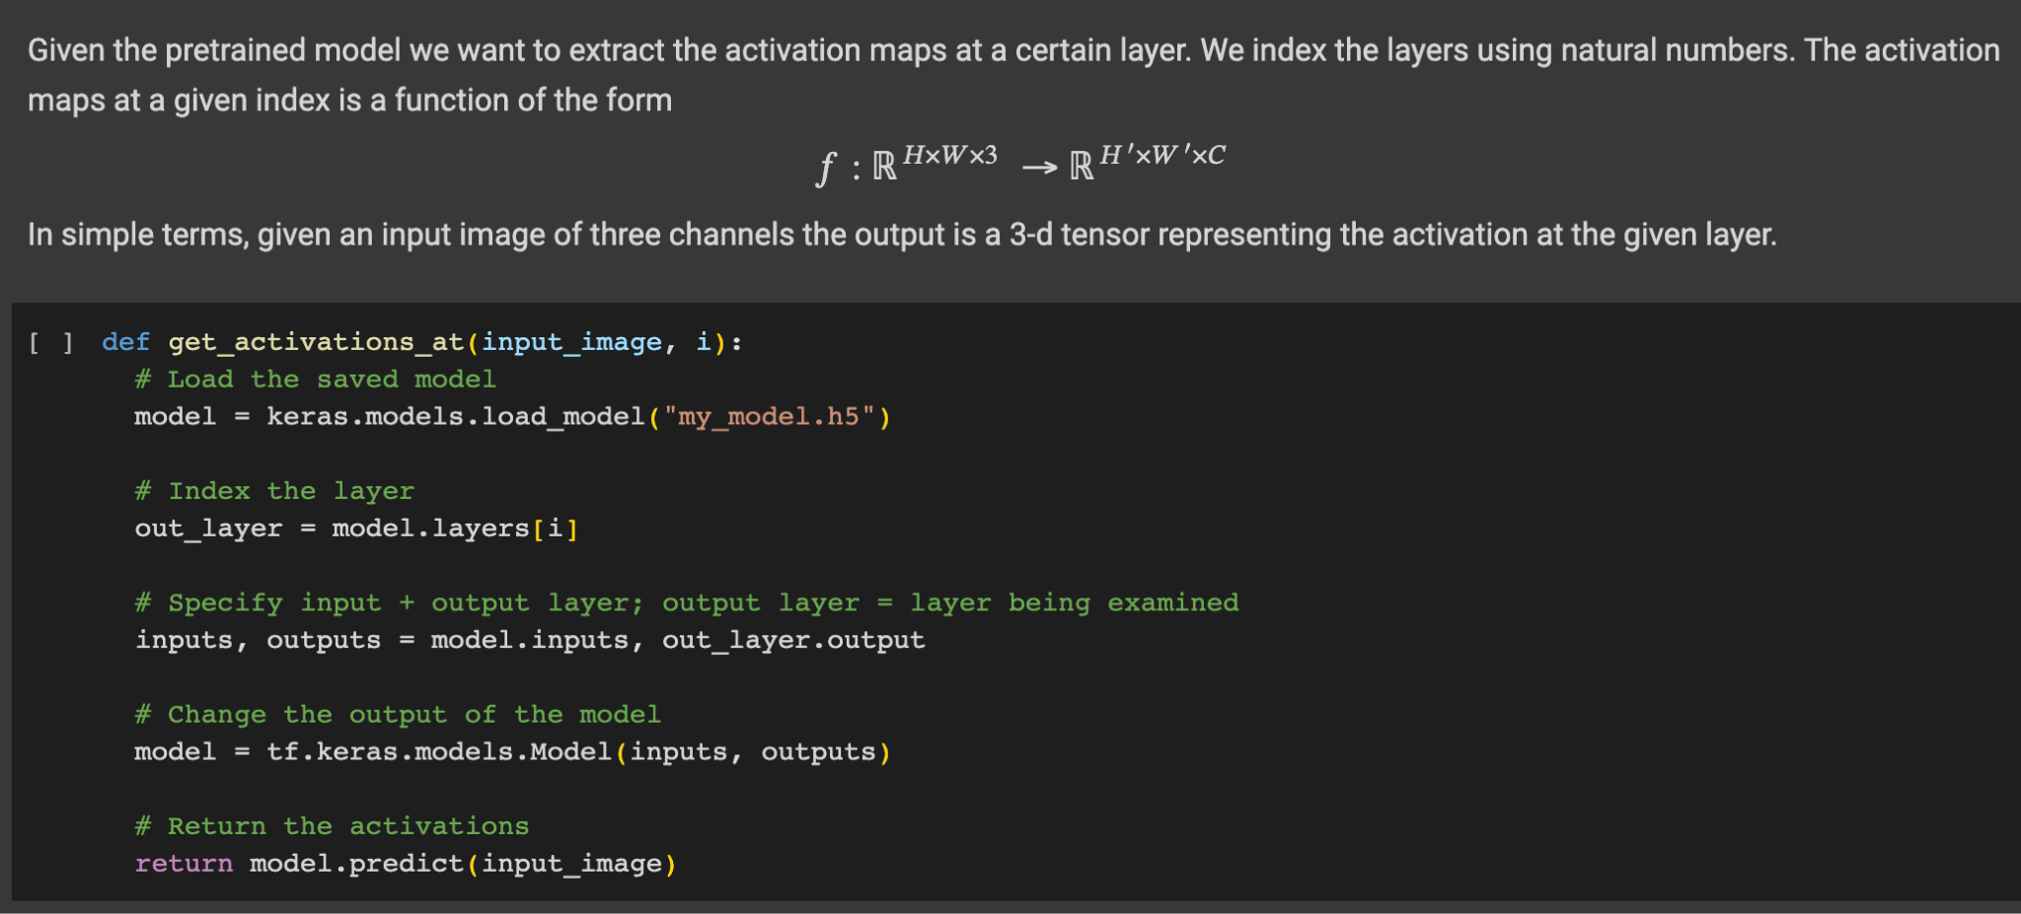
Back-Up Slide: Attention Maps
Notes:
Choose which layer you want your attention map to be on
Return the activations

Slide 32
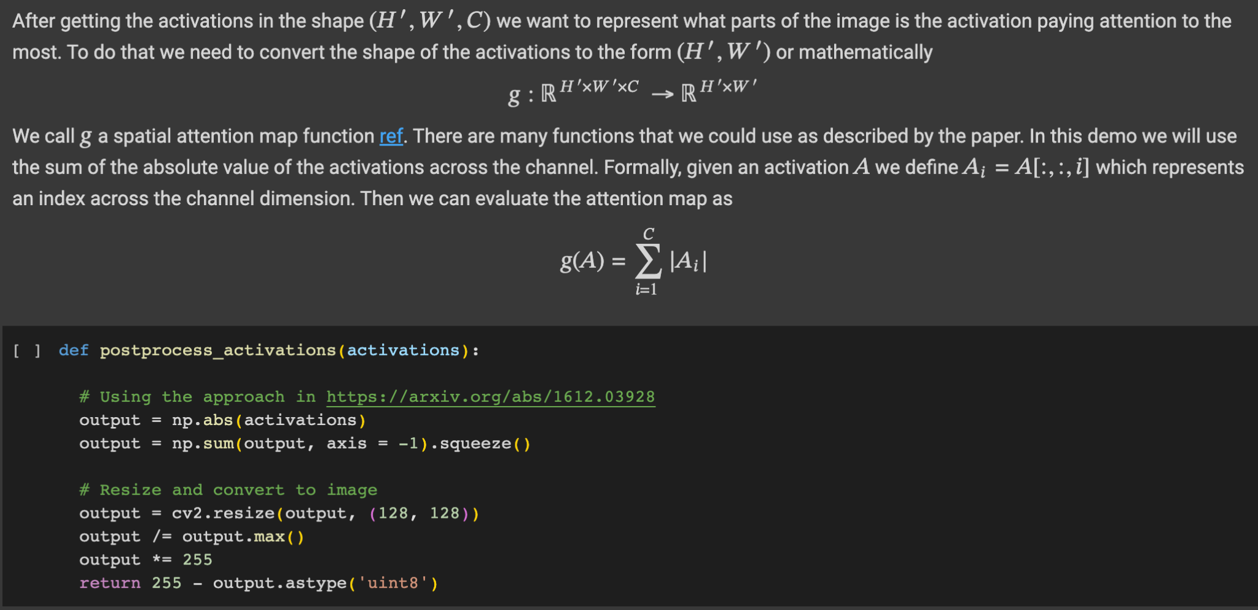
Back-Up Slide: Attention Maps
Notes:
Use activations to calculate the weights
Apply weights on input image

Slide 33
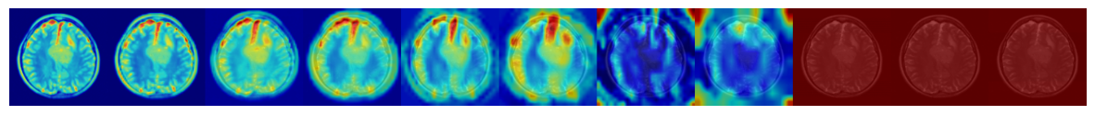
Back-Up Slide: Attention Map Layers
conv2d
max_pooling2d
conv2d_1
max_pooling2d_1
conv2d_2
conv2d_3
conv2d_4
max_pooling2d_2
flatten
dense
dense_1
Pooling layers reduce dimensionality
Scale has changed
Notes:
The pooling layers reduce the dimensionality/ resolution of the images, so in turn the attention maps appear blurrier
Dataset: https://www.kaggle.com/datasets/fernando2rad/brain-tumor-mri-images-44c

Slide 34
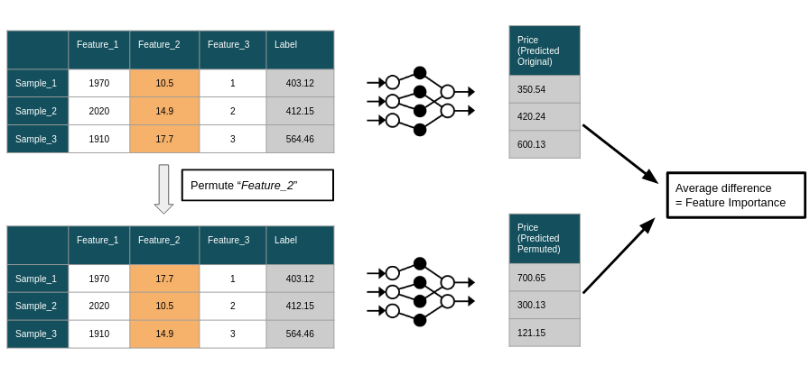
Back-Up Slide: How does feature importance work?
Source: https://www.modulos.ai/blog/permutation-feature-importance-deep-dive/
Notes:
There are different methods for calculating feature importance for different types of models, but the method used was called permutation importance. We randomly shuffle one column and then measure the decrease in overall performance as a result. The greater the decrease in performance, the greater the importance of that feature. If we continue this project we actually want to change our method for this because:
Limitations to permutation importance:
Analogy of changing one column of pixels in an image, as the number of features increases its less likely for this method to be effective
Varying things independently might lead to unrealistic data points bc you go out of distribution (for example if age was 5 and they had 10 prior arrests, or blue dog analogy)
Assumes features are not highly correlated. It only looks at features individually, some features may have low individual importance but contribute significantly when grouped with other features
How we could improve our feature importance:
Apply PCA (to reduce dimensionality while preserving important patterns) on our dataset to reduce dimensionality, instead of changing one column at a time we would change relevant groups of features.
Adversarial examples:

Slide 35
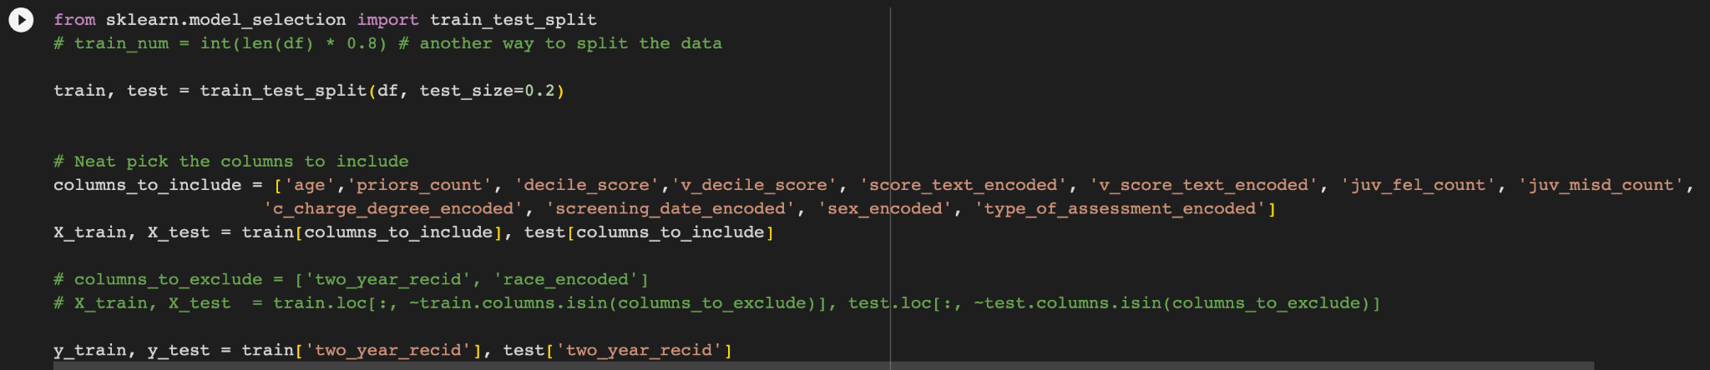
Back-Up Slide: COMPAS Features
Notes:
An academic paper on COMPAS stated that the only features (most suggested features) to go by for training and testing were sex, age and priors count. For our DNN, we included a few more solely for feature importance demonstrations, but it didn’t have a significant impact on the accuracy of the models
Dataset used: https://raw.githubusercontent.com/propublica/compas-analysis/master/compas-scores-two-years.csv
Paper referenced: https://www.science.org/doi/10.1126/sciadv.aao5580

Slide 36
Back-Up Slide: Other Ways to interpret CNNs
Visualize filters
Saliency Maps
Notes:
Visualization of filters: examines filters in the convolutional layers to understand what patterns or features they are detecting; best for first layer bc that's directly connected to pixels; feature maps don't quite look like images anymore in the later layers
Saliency maps: computing and normalizing (dividing by max value) the gradients and visualizing it since normalizing will give every gradient a number from 0-1 (basically attention maps but uses gradients instead of activation functions)
Activation maps: generate visualizations of feature activation maps to see which regions of an input image are most important for predictions
Class activation maps (CAM): highlights the regions of an image that contribute most to a specific predicted class.

Slide 37
Back-Up Slide: Other Ways to interpret DNNs
Gradient-Based Methods
Perturbation Methods
LRP
Notes:
Gradient-based methods: analyze gradients of the network with respect to the input to understand which input features have the most impact on the model's output
Perturbation analysis: modify the input to observe how it affects the model's predictions
Layer-wise relevance propagation (LRP): assigns relevance scores to different input features based on their contribution to the model's output

